Slide 1

ECE 530 Cloud Computing
Ioannis Papapanagiotou
AMQP and Exchanges

Slide 2
AMQP
AMQP = Advanced Message Queueing Protocol.
A binary, application layer protocol, designed to efficiently support a wide variety of messaging applications and communication patterns.
Provides flow controlled, message-oriented communication with message-delivery guarantees such as
at-most-once (where each message is delivered once or never),
at-least-once (where each message is certain to be delivered, but may do so multiple times) and
exactly-once (where the message will always certainly arrive and do so only once),
Authentication and/or encryption based on Simple Authentication and Security Layer (SASL) and/or Transport Layer Security (TLS).
It assumes an underlying reliable transport layer protocol such as Transmission Control Protocol (TCP).

Slide 3
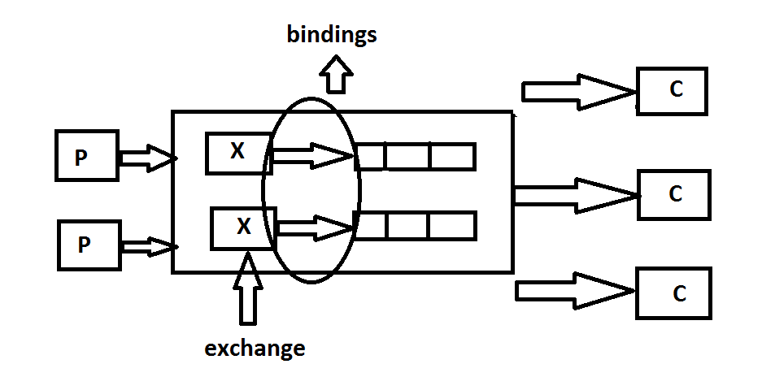
AMQP
AMQP = Advanced Message Queueing Protocol. The AMQP model contains Producers, Consumers, Exchanges, Queues, Bindings and Message broker.
Exchanges function as putting the messages received from the producer into the right queue present in the message broker.
Queues buffer up the messages until the consumer decides to fetch the messages.
The link between the exchange and the queue is called as Binding.

Slide 4
Types of Exchanges
There are 3 exchange types which tells us how the messages would be routed from the exchange to the queue.
Fan-out exchange: In the fan-out exchange every message received from the producer is stored in all the queues present in the message broker.
Direct exchange: The messages are stored in a queue when the routing key provided by the producer matches the binding key of the queue.
Topic exchange: It involves the use of wildcard keys in order to store messages to a particular queue.

Slide 5
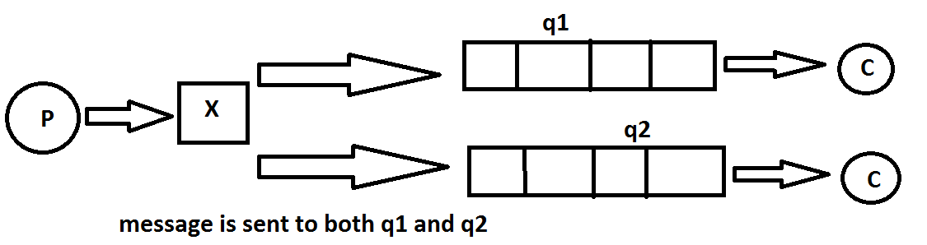
Fan-Out Exchange

Slide 6
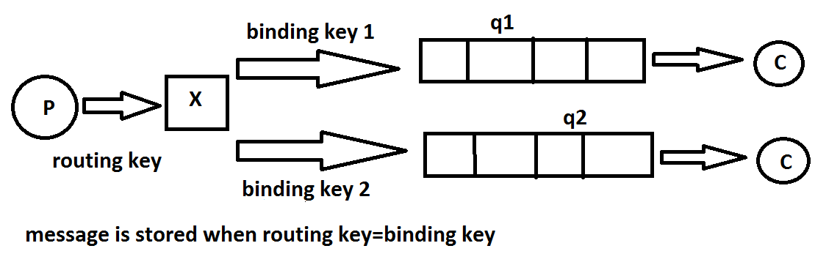
Direct Exchange

Slide 7
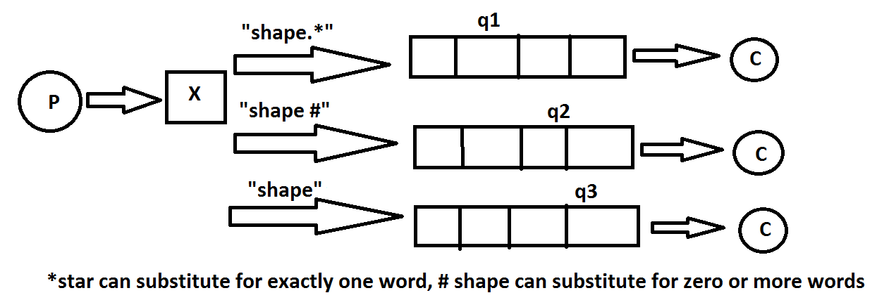
Topic Exchange

Slide 8
Nature of Queues
The nature of queues is described by the following three methods:
Transfer: The transfer of message takes place into the ends of the queue, this ensures an consistent order of messages within the queue.
Browsing: The messages stored in the queue are browsed from the side of the queue, this ensured a high amount of parallelism while accessing the messages from the queue and also ensures high throughput.
Synchronization: Whenever a copy of queue present in a message broker is created it is done using a particular order or using the sequence numbers similar to what TCP/IP does.

Slide 9
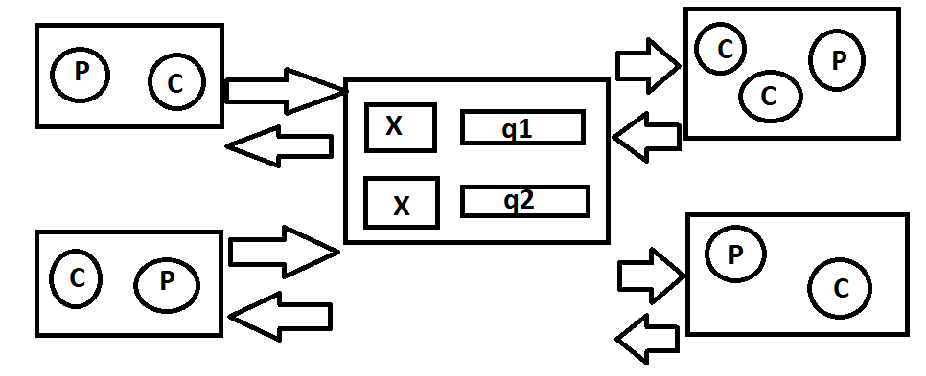
Messaging on the Cloud

Slide 10
Handling Failures
Failure to receive any ACK from broker the producer will try to send the same message again which leads to the duplication of messages.
There is a potential for processing of duplicate messages when consumer fails to ACK a processed message which is also known as redelivery.

